Slide 1

Continuous Retrieval of Replicated Data from Heterogeneous Storage Arrays
Nihat Altiparmak and Ali Saman Tosun
Mascots 2014
9/10/2014

Slide 2
Outline
Background
Big Data, Storage Arrays, Distributed and Heterogeneous Storage Architectures
Replicated Declustering and Retrieval
Continuous Retrieval Techniques
Batching, conservative, adaptive
Evaluation

Slide 3
Big Data
Total amount of data existing in the digital universe today is in the order of zettabytes (~ B) now and it is constantly growing
A couple of exabytes (~ B) of new information is created every day through sensors, Internet transactions, e-mails, social media, video surveillance, genome sequencing etc.
Many organizations store this data to enable breakthrough discoveries and innovation in science, engineering, medicine, commerce, national security etc.
Spent some time in a start-up receiving 2 petabytes (~ B) of data every month
As data grows, disk I/O performance needs further attention since it can significantly limit the performance and scalability of applications
Especially for high performance parallel I/O, efficient storage and retrieval of data is crucial

Slide 4
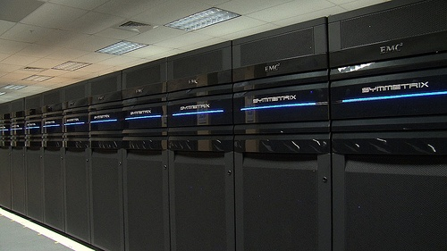
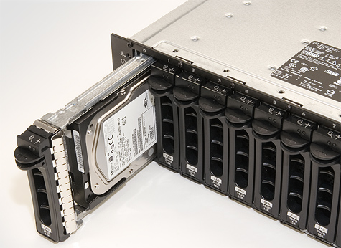
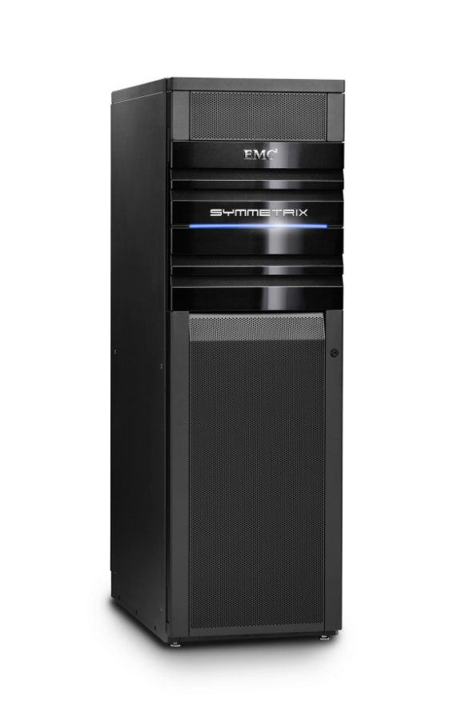
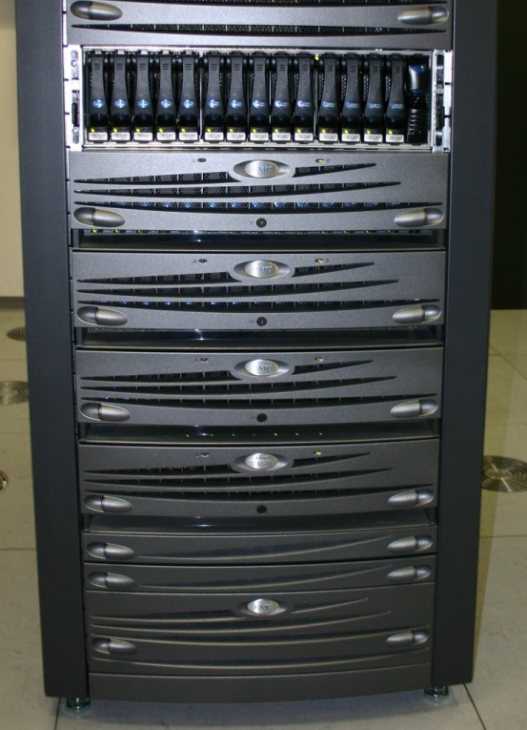
Storage Arrays
One way to achieve scalable storage and high performance I/O is the usage of storage arrays
A group of disk drives that collectively acts as a single storage system
Multiple disk drives
Controller (CPU + Memory)
Single EMC Symmetrix VMAX
240 disk drives
Four Quad-core 2.33 GHz Intel Xeon Processors
Up to 128 GB of memory
It is possible to connect multiple Vmax arrays
Up to 2400 drives and
1 TB of memory
Costs millions of dollars

Slide 5
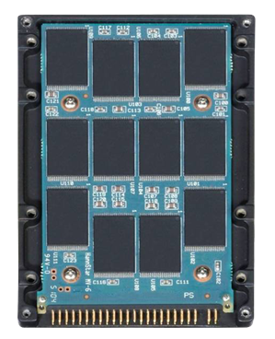
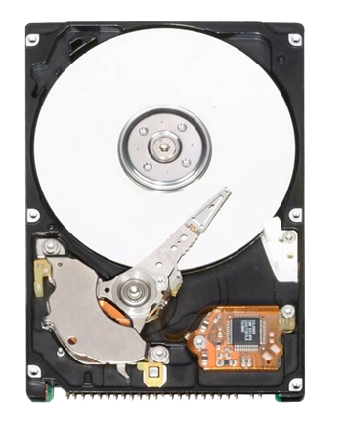
Storage Arrays
Traditionally, storage arrays are composed of rotating Hard Disk Drives (HDD)
7.2K Revolutions Per Minute (RPM)
10K RPM
15K RPM
Solid-state Drive (SSD)
Uses flash memory packages
Same interface as HDD, easily replaceable
Faster start-up, fast random access, low power consumption, silent operation, less heat, shock resistance
Expensive, wears out, limited capacity, slower sequential write

Slide 6
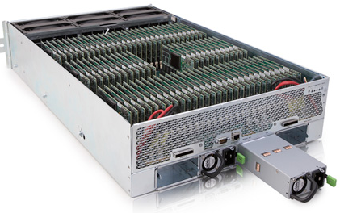
Flash and Hybrid Arrays
Entirely based on flash technology
Some flash arrays currently available: Nimbus S-Class, Nimbus E-Class, RamSan 810, Violin 6000, Violin 3000
Hybrid Storage Arrays: Balance cost and performance (SSD + HDD)
Better performance compared to homogeneous HDD based storage arrays, cheaper than homogeneous SSD based flash arrays
Some hybrid storage arrays currently available: EqualLogic PS6100XS, Zebi Storage Arrays, Adaptec Hybrid RAID Solutions
Violin 3200 Flash Array

Slide 7

Distributed and Heterogeneous Storage Architecture
15K RPM
HDD
15K RPM
HDD
SSD
SSD
SSD
SSD
SSD
SSD
HYBRID STORAGE ARRAY
FLASH ARRAY
10K RPM
HDD
10K RPM
HDD
10K RPM
HDD
10K RPM
HDD
HDD STORAGE ARRAY

Slide 8
Declustering for High Performance Parallel I/O
One Disk Access
Disk 0
Disk 1
Disk 2
Disk 3
Disk 4
0 | 1 | 2 | 3 | 4
1 | 2 | 3 | 4 | 0
2 | 3 | 4 | 0 | 1
3 | 4 | 0 | 1 | 2
4 | 0 | 1 | 2 | 3
₁
₂
₃
₄
₅
₆
₇
₈
₉
₁₀
Disk Modulo [Du’82]
Field-wise Exclusive OR [Kim’88]
Hilbert [Faloutsos’93]
Generalized Fibonacci [Prabhakar’98]
AOPT: Almost Optimal [Atallah’00]
₁₁
₁₂
₁₃
₁₄
₁₅
₁₆
₁₇
₁₈
₁₉
₂₀
₂₁
₂₂
₂₃
₂₄
₂₅

Slide 9
Replication
Replication is a common technique used for redundancy and better performance in declustering schemes
Several replicated declustering schemes were proposed recently
[Chen ’03], [Ferhat.’04], [Tosun’04 and ‘05], [Frikken’02 and ‘05], [Oktay’09], [Turk’12]
Optimal Response Time Retrieval (Replica Selection) Problem
N disks and |Q| buckets
Each bucket can be replicated among multiple disks
Find a retrieval schedule minimizing the retrieval time of the query Q
0 | 1 | 2 | 3 | 4 | 5 | 6
3 | 4 | 5 | 6 | 0 | 1 | 2
6 | 0 | 1 | 2 | 3 | 4 | 5
2 | 3 | 4 | 5 | 6 | 0 | 1
5 | 6 | 0 | 1 | 2 | 3 | 4
1 | 2 | 3 | 4 | 5 | 6 | 0
4 | 5 | 6 | 0 | 1 | 2 | 3
0 | 1 | 2 | 3 | 4 | 5 | 6
2 | 3 | 4 | 5 | 6 | 0 | 1
4 | 5 | 6 | 0 | 1 | 2 | 3
6 | 0 | 1 | 2 | 3 | 4 | 5
1 | 2 | 3 | 4 | 5 | 6 | 0
3 | 4 | 5 | 6 | 0 | 1 | 2
5 | 6 | 0 | 1 | 2 | 3 | 4
Query (Q)
Retrieval using the first copy requires two disk accesses
We can use the second copy to retrieve Q in one access
Which replica should be used for the best performance?
Replica 1
Replica 2

Slide 10
How to Solve the Basic Retrieval Problem
0 | 1 | 2 | 3 | 4 | 5 | 6
3 | 4 | 5 | 6 | 0 | 1 | 2
6 | 0 | 1 | 2 | 3 | 4 | 5
2 | 3 | 4 | 5 | 6 | 0 | 1
5 | 6 | 0 | 1 | 2 | 3 | 4
1 | 2 | 3 | 4 | 5 | 6 | 0
4 | 5 | 6 | 0 | 1 | 2 | 3
0 | 1 | 2 | 3 | 4 | 5 | 6
2 | 3 | 4 | 5 | 6 | 0 | 1
4 | 5 | 6 | 0 | 1 | 2 | 3
6 | 0 | 1 | 2 | 3 | 4 | 5
1 | 2 | 3 | 4 | 5 | 6 | 0
3 | 4 | 5 | 6 | 0 | 1 | 2
5 | 6 | 0 | 1 | 2 | 3 | 4
Max-flow solution
[Chen’93]
Disks are homogeneous
No initial load
No network delay
Generalized
Max-flow solution
[Altiparmak’12 and 13]
Buckets
1
Disks
0
[0,0]
1
Max-flow = |Q| = 6.
If not, increment
capacities of disk-t
edges and call
max-flow again.
O(|Q|) calls in the
worst case.
1
1
1
1
[0,1]
1
1
2
1
[1,0]
1
1
s
1
1
3
1
t
1
1
1
[1,1]
1
4
1
1
1
1
1
[2,0]
1
5
1
[2,1]
1
6

Slide 11
Continuous Retrieval
Max-flow guarantees the optimal retrieval schedule of a given (single) request
In reality, requests are arriving continuously
Finding the retrieval schedules individually might not result in the best performance
Request Queues Devices

Slide 12
Continuous Retrieval
We focus on optimizing continuous disk requests
Multiple trade-offs are considered:
Batching for better load balancing and smaller Service Time vs. immediately retrieving requests for shorter Waiting Time
Usage of a maximum flow based retrieval algorithm guaranteeing the optimal Service Time vs. a faster retrieval heuristic with lower Execution Time
Minimize Average Response (Elapsed)Time of disk requests considering their Waiting Time, Execution Time, and Service Time

Slide 13
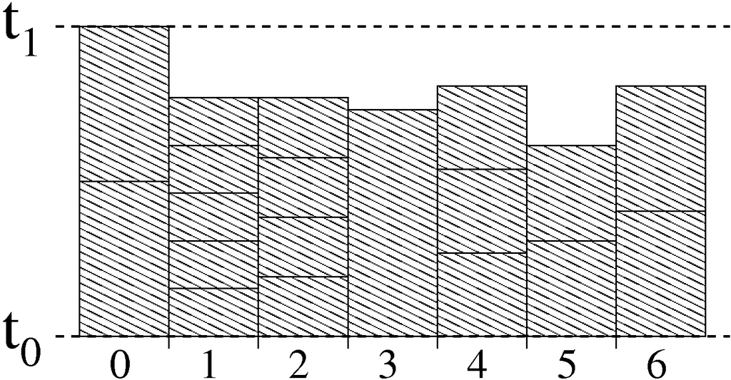
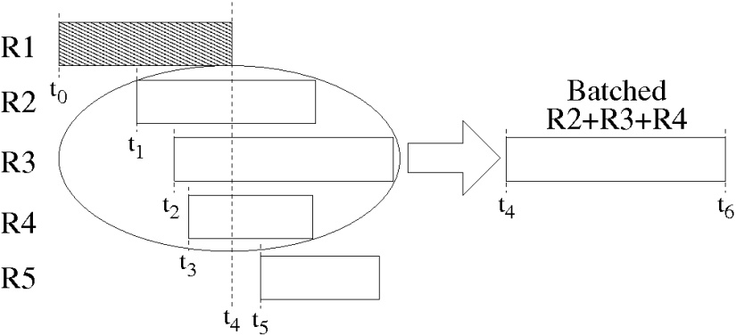
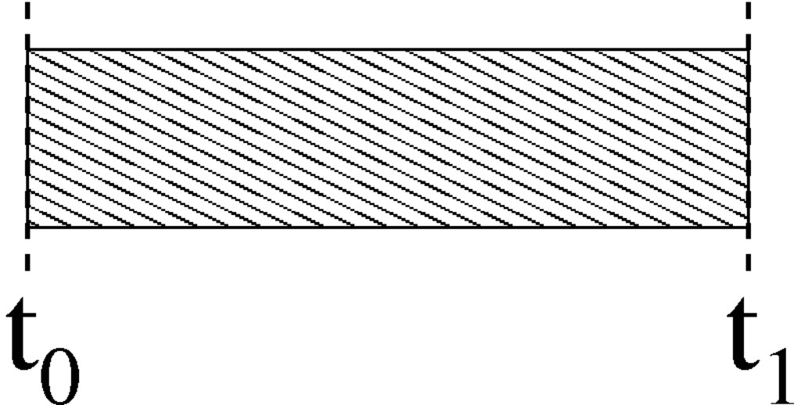
Batching
When a new request arrives;
If the storage system is idle
Determine the retrieval schedule
Else
Batch the incoming requests
Lower total Service Time (better load balancing)
Extra Waiting Time

Slide 14
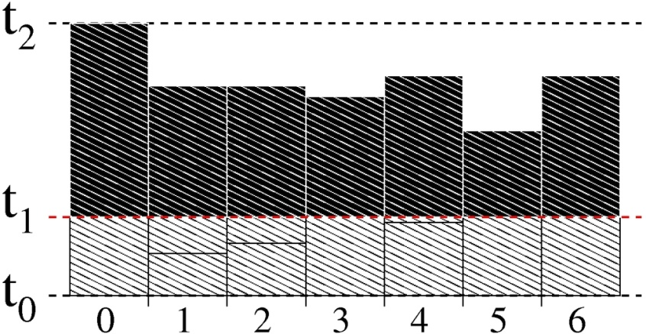
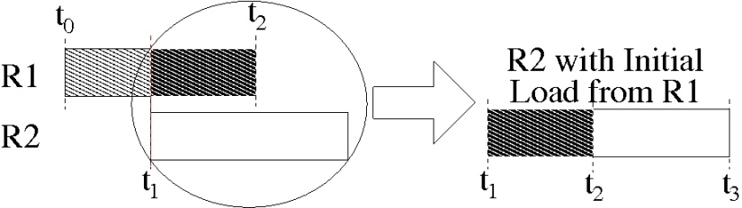
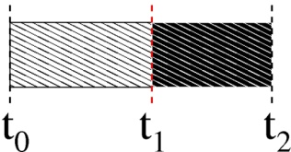
Immediate-conservative
When a new request arrives, immediately determine the retrieval schedule using the initial load information of the disks
Eliminates the Waiting Time introduced by the batching strategy
Expected to yield a larger total Service Time

Slide 15
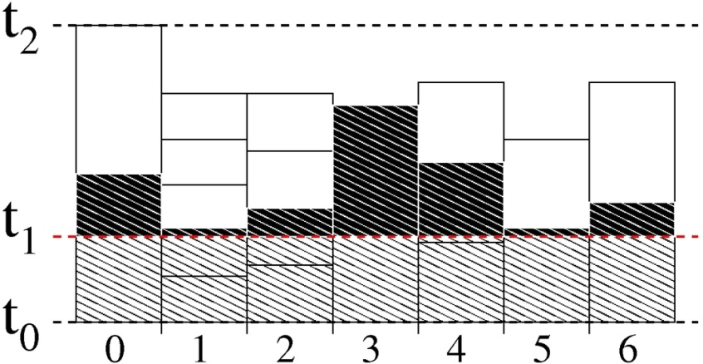
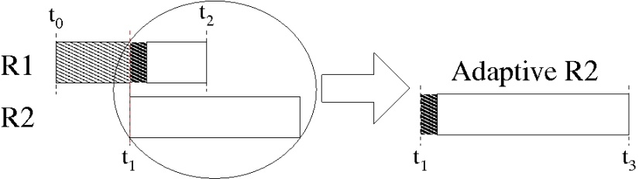
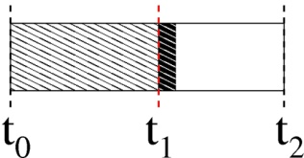
Immediate-adaptive
Allows rescheduling of the previously scheduled but non-retrieved buckets.
When a new request arrives, immediately determine the retrieval schedule using the initial loads and non-retrieved buckets
These non-retrieved buckets are combined with the new request providing more flexibility and resulting in better total Service Time

Slide 16
Evaluation
Simulations using real world traces
Exchange, TPC-E, TPC-C traces
Around 1K, 25K , 100K requests per second
Up to 2K , 120 , 200 number of buckets in each request
Homogeneous and heterogeneous storage configurations using real disk parameters
Used several retrieval algorithms/heuristics
Max-flow, random, shortest queue, online etc.

Slide 17
Exchange

Slide 18
References
[Altiparmak’12] N. Altiparmak and A. S. Tosun, Integrated maximum flow algorithm for optimal response time retrieval of replicated data, in ICPP’12.
[Altiparmak’13] N. Altiparmak and A. S. Tosun, Generalized optimal response time retrieval of replicated data from storage arrays, ACM Transactions on Storage, vol. 9, no. 2, pp. 5:1–5:36, Jul. 2013.
[Atallah’00] M. J. Atallah and S. Prabhakar. (Almost) optimal parallel block access for range queries, in PODS’00.
[Chen’93] L. T. Chen and D. Rotem. Optimal response time retrieval of replicated data, in PODS’94.
[Chen’03] C.-M. Chen and C. Cheng. Replication and Retrieval Strategies of Multidimensional Data on Parallel Disks, in CIKM’03.
[Du’82] H. C. Du and J. S. Sobolewski. Disk allocation for cartesian product ﬁles on multiple-disk systems. ACM Trans. on Database Systems, 7(1):82–101, March 1982.
[Faloutsos’93] C. Faloutsos and P. Bhagwat. Declustering using fractals, in PDIS’93.
[Ferhat.’04] H. Ferhatosmanoglu, A.S. Tosun, and A. Ramachandran, Replicated Declustering of Spatial Data, in PODS’04.
[Frikken ‘02] K. Frikken, M. J. Atallah, S. Prabhakar, and R. Safavi-Naini, Optimal parallel i/o for range queries through replication, in DEXA’02.
[Frikken ‘05] K. Frikken, Optimal distributed declustering using replication, in ICDT’’05.
[Kim’88] M. H. Kim and S. Pramanik. Optimal ﬁle distribution for partial match retrieval, in SIGMOD,’88.
[Oktay’09] K. Yasin Oktay, A. Turk, and C. Aykanat. Selective Replicated Declustering for Arbitrary Queries, in Euro-Par’09.
[Prabhakar’98] S. Prabhakar, K. Abdel-Ghaffar, D. Agrawal, and A. El Abbadi. Cyclic allocation of two-dimensional data, in ICDE’93.
[Tosun’04] A.S. Tosun. Replicated Declustering for Arbitrary Queries, in SAC’ 04.
[Tosun’05] A.S. Tosun. Design Theoretic Approach to Replicated Declustering, in ITCC’05.
[Turk’12] A. Turk, K. Y. Oktay, and C. Aykanat. Query-Log Aware Replicated Declustering. IEEE Transactions on Parallel and Distributed Systems, vol. 99, no. PrePrints, 2012

Slide 19

Thank You!
Any Questions?

