Slide 1
Integrated Maximum Flow Algorithm for Optimal Response Time Retrieval of Replicated Data
Nihat Altiparmak, Ali Saman Tosun
The University of Texas at San Antonio

Slide 2
Declustering and Parallel I/O
1 Access
Disk 0
Disk 1
Disk 2
Disk 3
Disk 4
0 | 1 | 2 | 3 | 4
1 | 2 | 3 | 4 | 0
2 | 3 | 4 | 0 | 1
3 | 4 | 0 | 1 | 2
4 | 0 | 1 | 2 | 3
₁
₂
₃
₄
₅
₆
₇
₈
₉
₁₀
₁₁
₁₂
₁₃
₁₄
₁₅
₁₆
₁₇
₁₈
₁₉
₂₀
₂₁
₂₂
₂₃
₂₄
₂₅

Slide 3
Replication
Replication is a common technique used for redundancy and better performance in declustering schemes
Retrieval using the first copy requires two accesses
We can use the second copy to retrieve in one access
Problem: Which copy to use for the best performance?
0 | 1 | 2 | 3 | 4 | 5 | 6
3 | 4 | 5 | 6 | 0 | 1 | 2
6 | 0 | 1 | 2 | 3 | 4 | 5
2 | 3 | 4 | 5 | 6 | 0 | 1
5 | 6 | 0 | 1 | 2 | 3 | 4
1 | 2 | 3 | 4 | 5 | 6 | 0
4 | 5 | 6 | 0 | 1 | 2 | 3
0 | 1 | 2 | 3 | 4 | 5 | 6
2 | 3 | 4 | 5 | 6 | 0 | 1
4 | 5 | 6 | 0 | 1 | 2 | 3
6 | 0 | 1 | 2 | 3 | 4 | 5
1 | 2 | 3 | 4 | 5 | 6 | 0
3 | 4 | 5 | 6 | 0 | 1 | 2
5 | 6 | 0 | 1 | 2 | 3 | 4
Copy 1
Copy 2

Slide 4
Optimal Response Time Retrieval Problem Definition
N disks |Q| buckets
Each bucket can be replicated among multiple disks
Find a retrieval schedule so that the response time of the query Q is minimized

Slide 5
Basic Retrieval Problem
0 | 1 | 2 | 3 | 4 | 5 | 6
3 | 4 | 5 | 6 | 0 | 1 | 2
6 | 0 | 1 | 2 | 3 | 4 | 5
2 | 3 | 4 | 5 | 6 | 0 | 1
5 | 6 | 0 | 1 | 2 | 3 | 4
1 | 2 | 3 | 4 | 5 | 6 | 0
4 | 5 | 6 | 0 | 1 | 2 | 3
0 | 1 | 2 | 3 | 4 | 5 | 6
2 | 3 | 4 | 5 | 6 | 0 | 1
4 | 5 | 6 | 0 | 1 | 2 | 3
6 | 0 | 1 | 2 | 3 | 4 | 5
1 | 2 | 3 | 4 | 5 | 6 | 0
3 | 4 | 5 | 6 | 0 | 1 | 2
5 | 6 | 0 | 1 | 2 | 3 | 4
Disks are homogeneous
No initial load
No network delay
Max-flow solution
[Chen’93]
Buckets
1
Disks
0
[0,0]
1
Max-flow = |Q| = 6.
If not, increment
capacities of disk-t
edges and call
max-flow again.
O(|Q|) calls in the
worst case.
1
1
1
1
[0,1]
1
1
2
1
[1,0]
1
1
s
1
1
3
1
t
1
1
1
[1,1]
1
4
1
1
1
1
1
[2,0]
1
5
1
[2,1]
1
6

Slide 6
Generalized Retrieval Problem
Heterogeneous Disks
  Disks might have different response times depending on the rotational speed (7.2K, 10K, 15K RPM etc.), interface (SCSI, IDE etc.), and underlying technology (HDD, SSD etc.)
  Retrieval from the fastest disk is preferred
Multi-site Retrieval and Network Delay
  Data might be distributed among multiple storage arrays located on different servers
  Retrieval from the server with minimum network delay is preferred.
Initial Load
  A disk might have an initial load to be retrieved from previous queries
  Retrieval from the disk with minimum or possibly no initial load is preferred

Slide 7
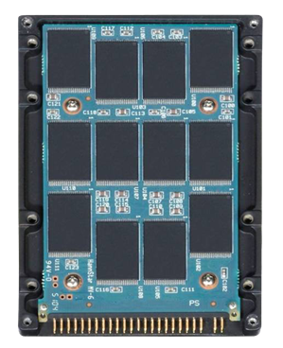
Generalized Retrieval Problem
Generalized retrieval problem can be solved using binary capacity scaling and capacity incrementation techniques proposed in [Altiparmak’12]
15K RPM
HDD
15K RPM
HDD
SSD
SSD
Network Delay
SSD
SSD
SSD
SSD
HYBRID STORAGE ARRAY
SSD STORAGE ARRAY
Initial Load
10K RPM
HDD
10K RPM
HDD
10K RPM
HDD
10K RPM
HDD
HDD STORAGE ARRAY

Slide 8
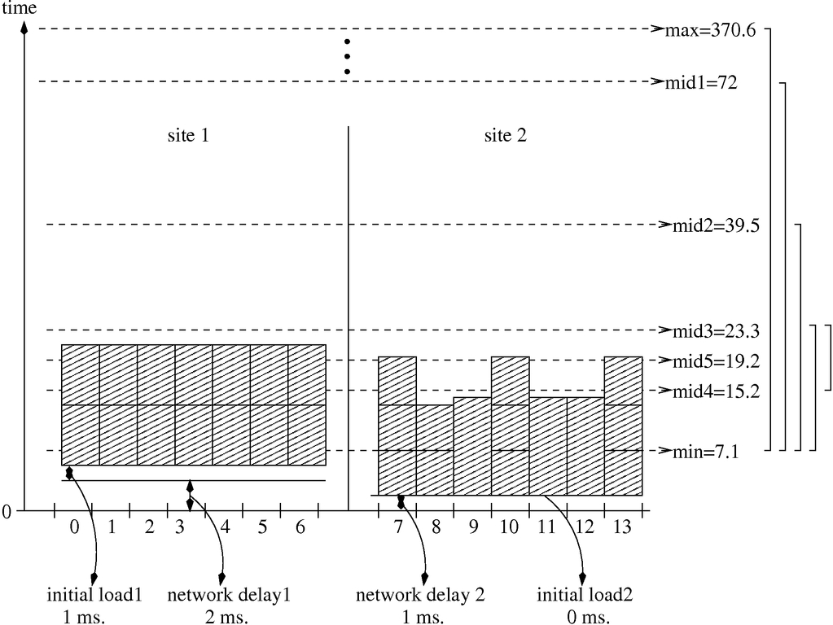
Generalized Retrieval Problem
Fact:
Site 1
Site 2
Deciding the retrieval schedule is a time critical issue
Max-flow is called multiple times as a block box function with similar capacity values
Flow values within consecutive calls cannot be conserved
Same flow calculations are performed over and over
Can we conserve the flows within multiple runs of max-flow?
  Integrated maximum flow alg.
Can we make it even faster?
  Parallel int. maximum flow alg.
0 | 1 | 2 | 3 | 4 | 5 | 6
3 | 4 | 5 | 6 | 0 | 1 | 2
6 | 0 | 1 | 2 | 3 | 4 | 5
2 | 3 | 4 | 5 | 6 | 0 | 1
5 | 6 | 0 | 1 | 2 | 3 | 4
1 | 2 | 3 | 4 | 5 | 6 | 0
4 | 5 | 6 | 0 | 1 | 2 | 3
0 | 1 | 2 | 3 | 4 | 5 | 6
2 | 3 | 4 | 5 | 6 | 0 | 1
4 | 5 | 6 | 0 | 1 | 2 | 3
6 | 0 | 1 | 2 | 3 | 4 | 5
1 | 2 | 3 | 4 | 5 | 6 | 0
3 | 4 | 5 | 6 | 0 | 1 | 2
5 | 6 | 0 | 1 | 2 | 3 | 4
Observation:
RUN MAX-FLOW
Use Capacity Incrementation!
Use Capacity Scaling!
Limitations:
Contributions:

Slide 9
Talk Outline
Motivation and Background
Ford-Fulkerson Based Solution
Push-relabel Based Solution
Parallel Push-relabel Solution
Evaluation
Conclusion

Slide 10
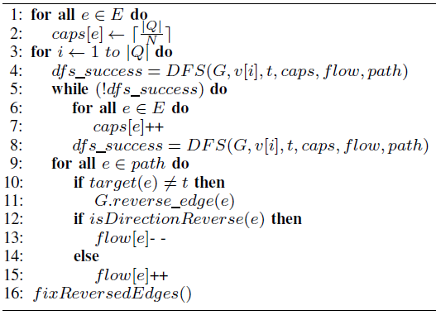
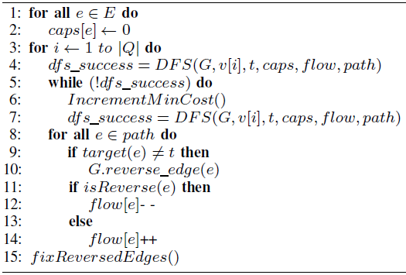
Ford-Fulkerson Based Solution
Uses augmenting path method
Repeatedly sends flow along augmenting paths until no such path remains
Ford-Fulkerson based integrated algorithm proposed in [Chen’93] for the basic retrieval problem can easily be modified for the generalized case
Basic Retrieval Case [Chen’93]
Generalized Retrieval Case

Slide 11
Talk Outline
Motivation and Background
Ford-Fulkerson Based Solution
Push-relabel Based Solution
Parallel Push-relabel Solution
Evaluation
Conclusion

Slide 12
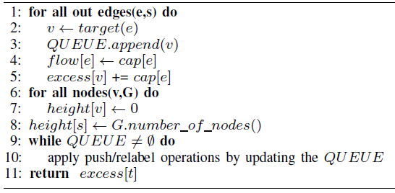
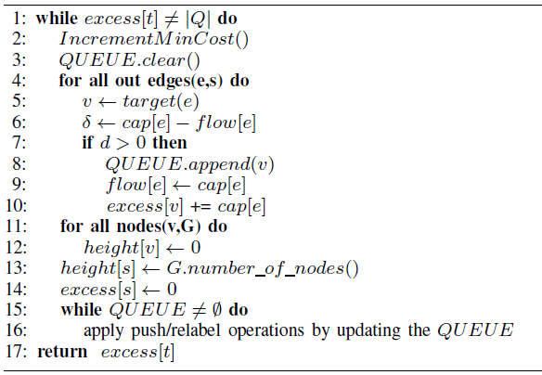
Push-relabel Based Solution
Sends flow along individual edges instead of the entire augmenting path
Leads to better performance [Goldberg’88]
Most practical implementations are based on push-relabel algorithm
Push-relabel Algorithm
Generalized Retrieval Case
Condition to stop (Flow=|Q|)
Initialization
Initialization

Slide 13
Push-relabel Based Solution
Considers all possible retrieval times starting from the minimum in an exhaustive search manner. Worst case complexity is
Adapt the binary capacity scaling technique presented in [Altiparmak’12].
  Worst case complexity becomes
Performs better in practice thanks to the flow conservation property
Push-relabel operations are unchanged, integrated algorithm can easily be parallelized!

Slide 14
Talk Outline
Motivation and Background
Ford-Fulkerson Based Solution
Push-relabel Based Solution
Parallel Push-relabel Solution
Evaluation
Conclusion

Slide 15
Parallel Push-relabel Solution
Most new generation storage arrays are powered with multi-core processors
  EMC Symmetrix VMAX has four Quad-core 2.33 GHz Intel Xeon Processors
We can reduce the computation time further by using parallel push-relabel implementation
Many parallel push-relabel algorithms are proposed
  [Goldberg’88], [Anderson’92], [Bader’05], [Hong’11]
Most recent implementation in [Hong’11] claims to outperform others.

Slide 16
Parallel Push-relabel Solution:
[Hong’11]’s Implementation
Uses the push-relabel technique proposed in [Goldberg’88]
Multiple processes/threads do not need any locks or barriers to protect the push and relabel operations
Each thread independently determines its own termination without using any locks or barriers
Requires atomic read-modify-write instructions
  Shared flow and excess values are updated by multiple threads using atomic operations
Complexity:
We use [Hong’11]’s implementation for our parallel push-relabel based solution

Slide 17
Talk Outline
Motivation and Background
Ford-Fulkerson Based Solution
Push-relabel Based Solution
Parallel Push-relabel Solution
Evaluation
Conclusion

Slide 18
Evaluation
Algorithms are implemented in C++ except the parallel implementation, which uses C with pthreads
We used LEDA 3.4.1 library for the graph structure and black-box max-flow calculation
  LEDA uses Goldberg and Tarjan’s Push-relabel algorithm for max-flow (O(|V|³) complexity)
Integrated Push-relabel algorithm is implemented on top of LEDA’s max-flow implementation for fair comparison
Algorithms are compiled using gcc/g++ version 4.4.3 and compiler optimization levels resulting the fastest execution time

Slide 19
Evaluation: Query Loads
Load 1
  Distribution of queries are similar to the distribution of the queries in a particular query type (Range, Arbitrary, or Connected )
  Expected bucket size is for range queries and for arbitrary queries
Load 2
  Distribution of queries is uniform. Expected bucket size is
Load 3
  Smaller queries are more likely.
  Expected bucket size is much smaller than the other loads, .

Slide 20
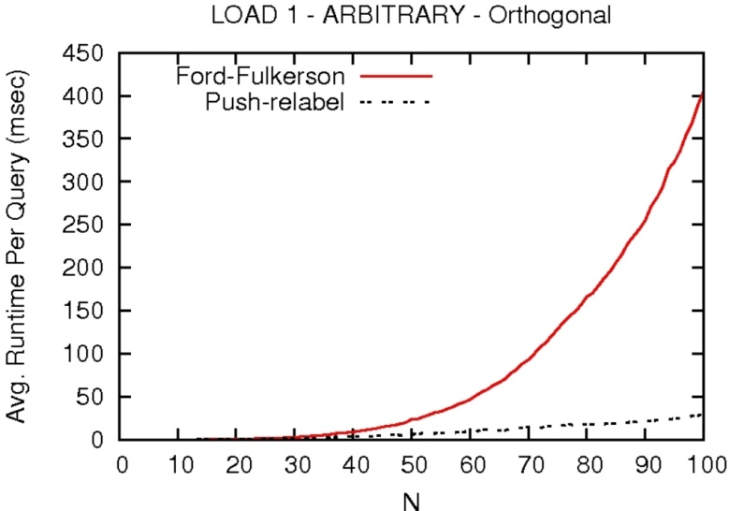
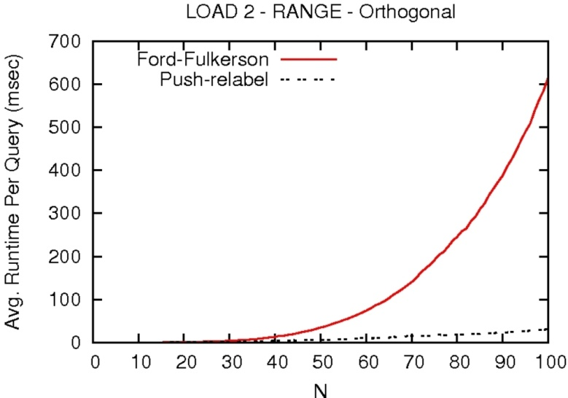
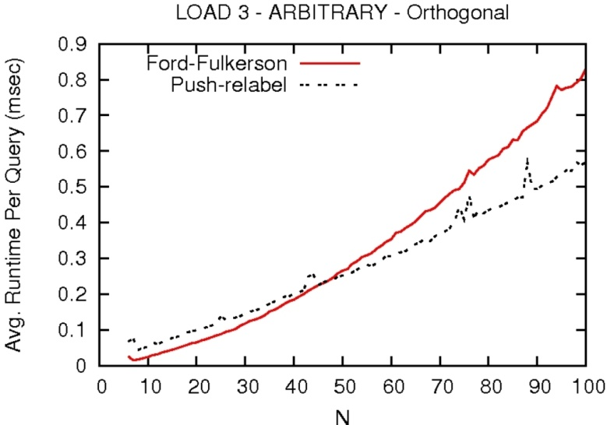
Execution Time: Ford-Fulkerson vs. Push-relabel
Load 1
Load 2
Load 3

Slide 21
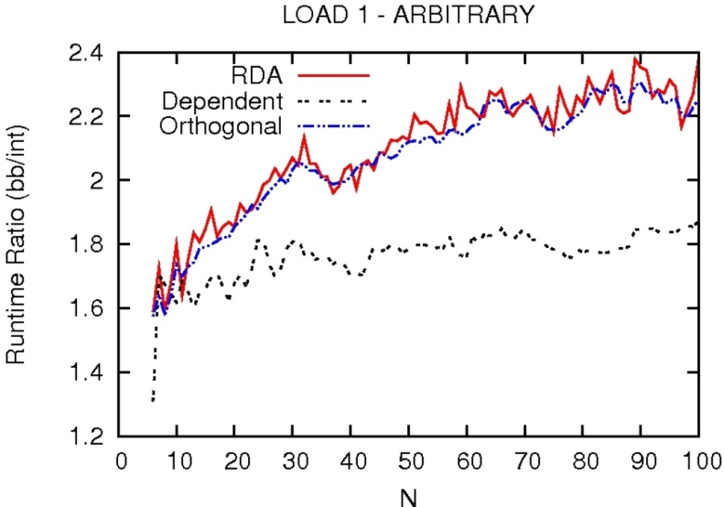
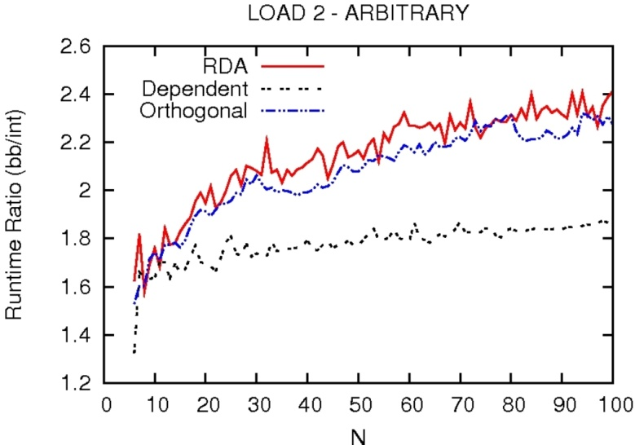
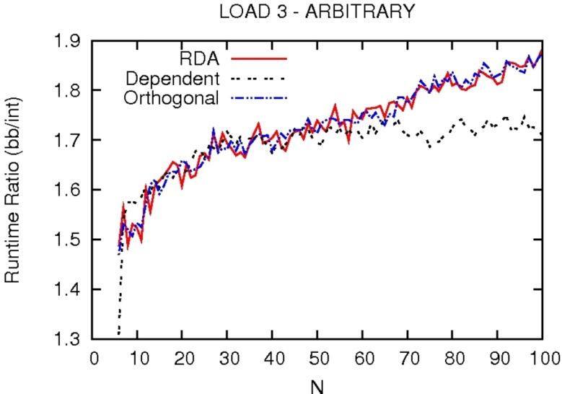
Execution Time Ratio: Push-relabel Black-Box/Integrated
Load 1
Load 2
Load 3

Slide 22
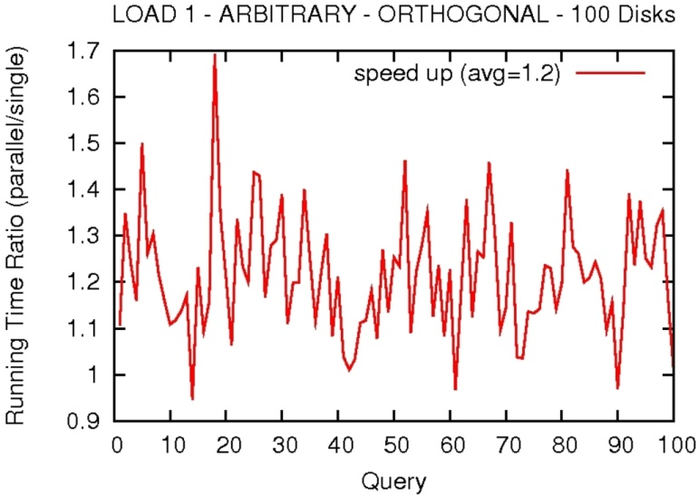
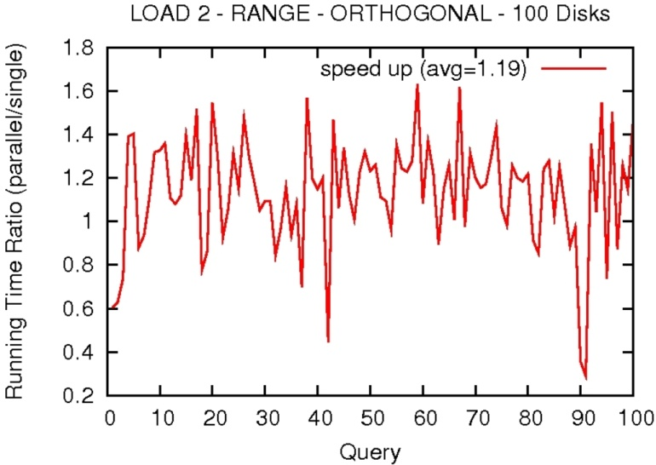
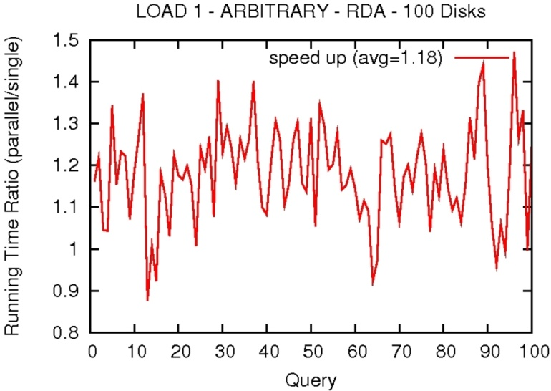
Execution Time Ratio: Push-relabel Sequential/Parallel
Load 1
Load 2
Load 1

Slide 23
Talk Outline
Motivation and Background
Ford-Fulkerson Based Solution
Push-relabel Based Solution
Parallel Push-relabel Solution
Evaluation
Conclusion

Slide 24
Conclusion
Integrated Push-relabel based algorithm is up to 2.5X faster than the existing black-box counterpart
Parallel implementation achieves a maximum speed-up of 1.7X (1.2X on avg.) over the sequential integrated algorithm using two threads
  For small queries of load 3 and more than two number of threads, we observed a load-balancing issue
Together with the parallel push-relabel implementation, proposed algorithm runs up to 4.25X (3X on avg.) faster than the existing black-box algorithm

Slide 25
References
[Altiparmak’12] Nihat Altiparmak and A. S¸ . Tosun. Generalized optimal response time retrieval of replicated data from storage arrays. http://gozde.cs.utsa.edu/TR1.pdf, 2012. Technical Report.
[Anderson’92] Richard J. Anderson and Joao C. Setubal. On the parallel implementation of goldberg’s maximum flow algorithm. In Proceedings of the fourth annual ACM symposium on parallel algorithms and architectures, SPAA’92, pages 168–177, New York, NY, USA, 1992. ACM.
[Bader,05] David A. Bader and Vipin Sachdeva. A cache-aware parallel implementation of the push-relabel network flow algorithm and experimental evaluation of the gap relabeling heuristic. In ISCA PDCS, pages 41–48, 2005.
[31] Bo Hong and Zhengyu He. An asynchronous multithreaded algorithm for the maximum network flow problem with nonblocking global relabeling heuristic. IEEE Transactions on Parallel and Distributed Systems, 22(6):1025 –1033, june 2011.
[Chen’93] L. T. Chen and D. Rotem. Optimal response time retrieval of replicated data. In ACM SIGACT-SIGMOD-SIGART Symposium on Principles of Database Systems, pages 36–44, 1994.
[Goldberg’88] Andrew V. Goldberg and Robert E. Tarjan. A new approach to the maximum flow problem. Journal of the ACM, 35:921–940, 1988.

Slide 26

Thank You!
Questions?

